Slide 1


Slide 2
What is Flutter?
Released in May 2017, flutter is Google’s open source mobile UI framework
Allows developers to create high-quality natively compiled applications for mobile, web, and desktop from a single codebase
It is based on Google Programming Language called Dart

Slide 3
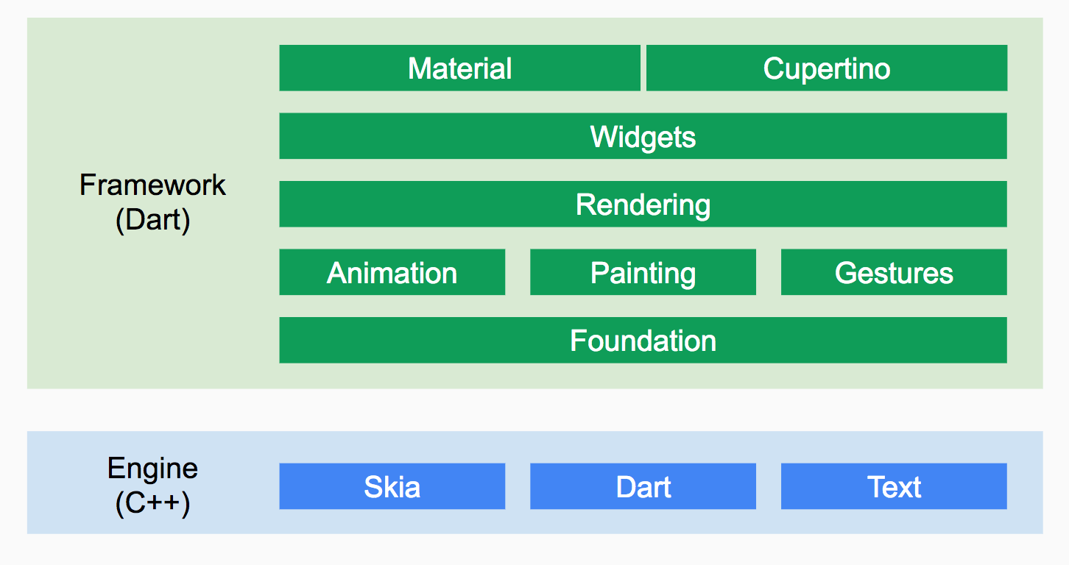
Architecture

Slide 4
Features:
Flutter uses C++ rendering engine
Architecture is based on reactive programming
Fast development:
Stateful Hot Reload
Use a rich set of fully-customizable widgets to build native interfaces
Expressive and Flexible UI

Slide 5
Continued..
Native Performance:
Flutter code is compiled to native ARM machine code using Dart's native compilers
IDE:
Supportive for an extensive array of IDEs that include Xcode, Visual Studio Code and Android Studio
You get the extra support for Google’s Firebase development platform.

Slide 6
Everything’s a widget
Widgets are the basic building blocks of a Flutter app’s UI.
Each widget nests inside, and inherits properties from, its parent.
A widget is either stateful or stateless:
A Stateful widget is dynamic: e.g., it can change its appearance in response to events triggered by user interactions or when it receives data.
Stateless widgets do not require mutable state, i.e., it is immutable.

Slide 7
Installation
https://flutter.dev/docs/get-started/install/macos

Slide 8
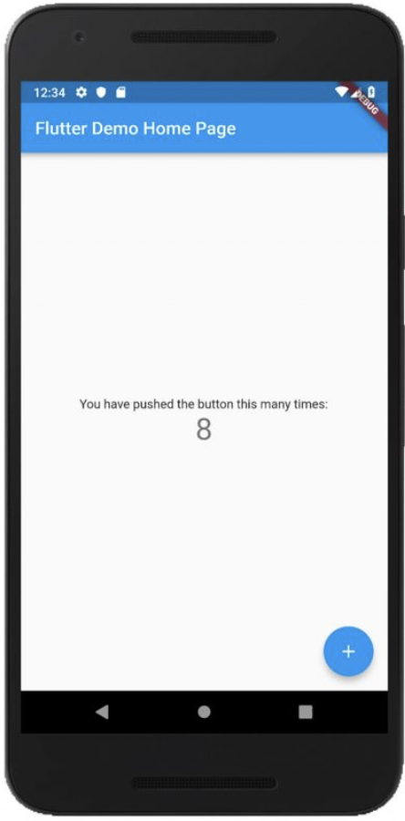
Create and run a simple Flutter app
$ flutter create my_app
$ cd my_app
$ flutter run

Slide 9
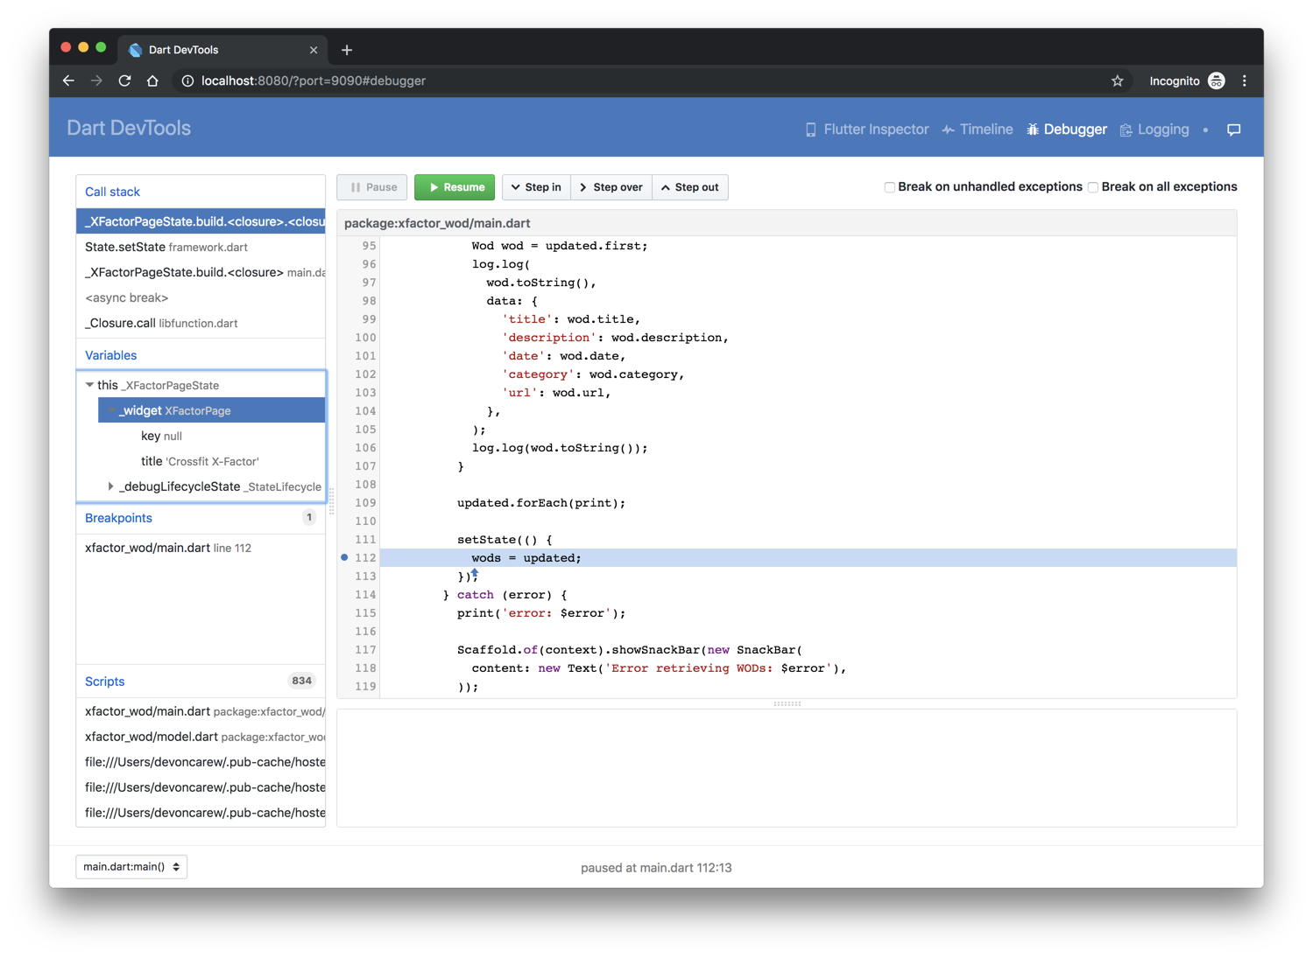
Debugging
DevTools includes a full source-level debugger, supporting breakpoints, stepping, and variable inspection.

Slide 10
Testing
A unit test tests a single function, method, or class.
A widget test tests a single widget.
An integration test tests a complete app or a large part of an app.

Slide 11
Pros
Ready-made and custom widgets for fast UI coding
Single codebase for web, mobile and embedded platforms
Dart – simple and effective language targeted at Java programmers
Hot reload function for instantaneous updates
The mildest learning curve and a growing community
More Firebase APIs assistance
Excellent User Interfaces
Perfect for an MVP

Slide 12
Cons
Since it is coded in Dart language, a developer needs to learn new language.
Lack of third-party libraries
Large number of open issues in GitHub (5000+)
Image I/O can be expensive
Massive File Size
Flutter caters to mobile apps only and isn’t supported by web browsers.

Slide 13









Who is using Flutter?
Google Ads
Reflectly
JD Finance

Slide 14
Documentation & Community Support
https://flutter.dev/docs/get-started/install
https://flutter.dev/docs/development/ui/widgets
https://api.flutter.dev/
https://flutter.dev/docs/cookbook
https://github.com/flutter/samples/blob/master/INDEX.md
https://www.youtube.com/flutterdev
https://dart.dev/

Slide 15
Thank You!!

